Slide 1
VLA Functional Block Diagram
GUI
PRELAB
LAB
Theory
Pretest:
Theory
Simulation
With Q/A
Image
Processing
Safety
Video
Safety
Test
Hardware
Post
Test
Lab
Report
Steve
Sung
HELP
Videos
Pretest
Help
Simulation
Help
Hardware
Help
Post Test
Help
General
Help
Tal
SPEECH
Record
Speech
Process
Speech
Help
Interrupt
Sal
WEB
Prelab
(same as above)
Help
(same as above)

Slide 2
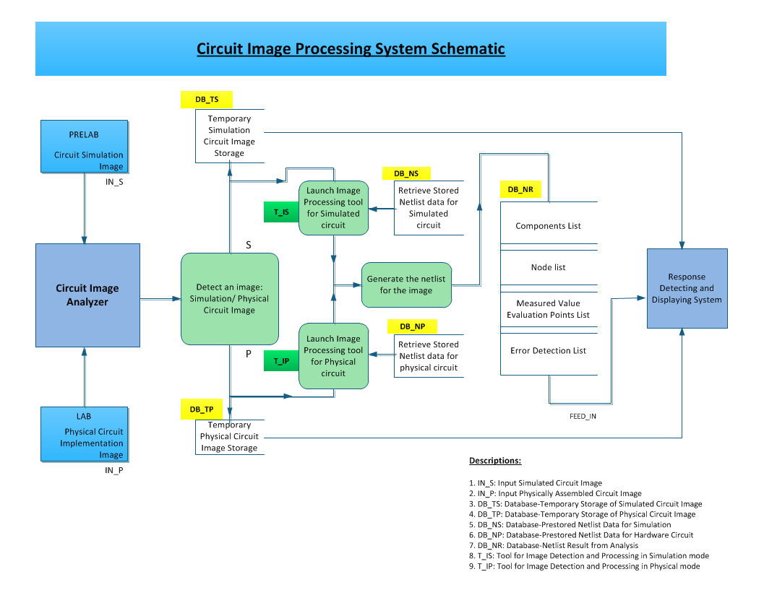

Slide 4
Circuit Trace Maker Process

Slide 5
Functional Block Diagram
GUI
PRELAB
LAB
Theory
Pretest:
Theory
Simulation
With Q/A
Image
Processing
Safety
Video
Safety
Test
Hardware
Post
Test
Lab
Report
Steve
Sung
HELP
Videos
Pretest
Help
Simulation
Help
Hardware
Help
Post Test
Help
General
Help
Tal
SPEECH
Record
Speech
Process
Speech
Help
Interrupt
Sal
WEB
Prelab
(same as above)
Help
(same as above)

Slide 7
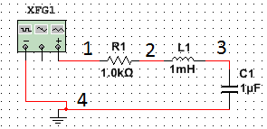
Sample Output

Slide 8
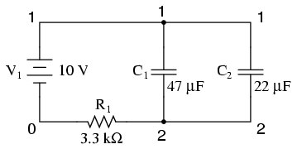
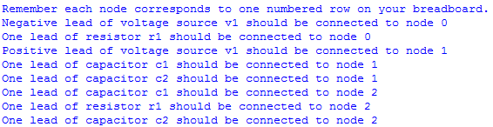
Sample Output

Slide 9
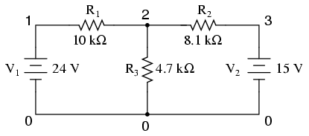
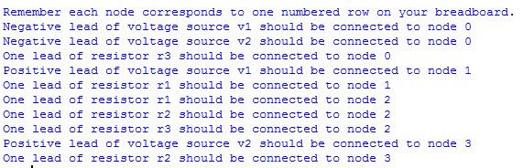
Sample Output

